Slide 1

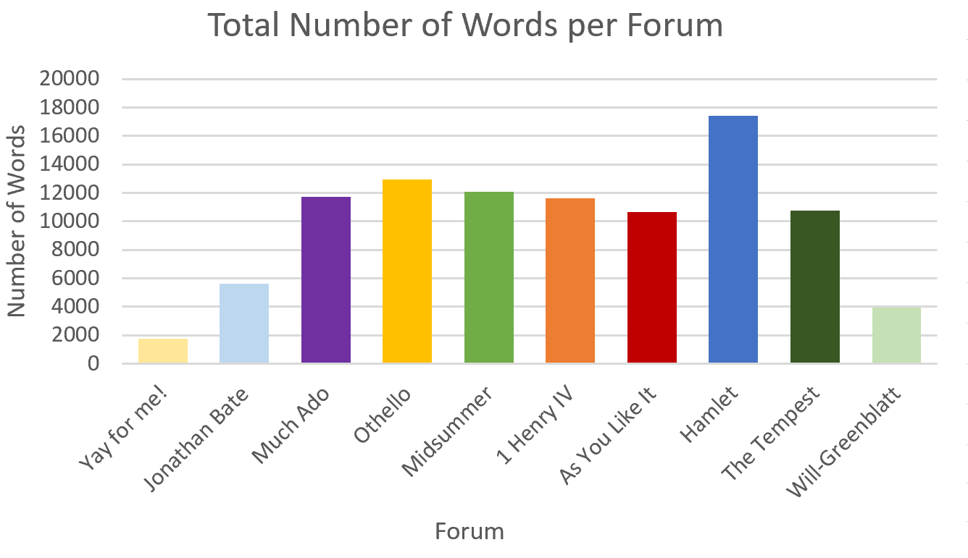
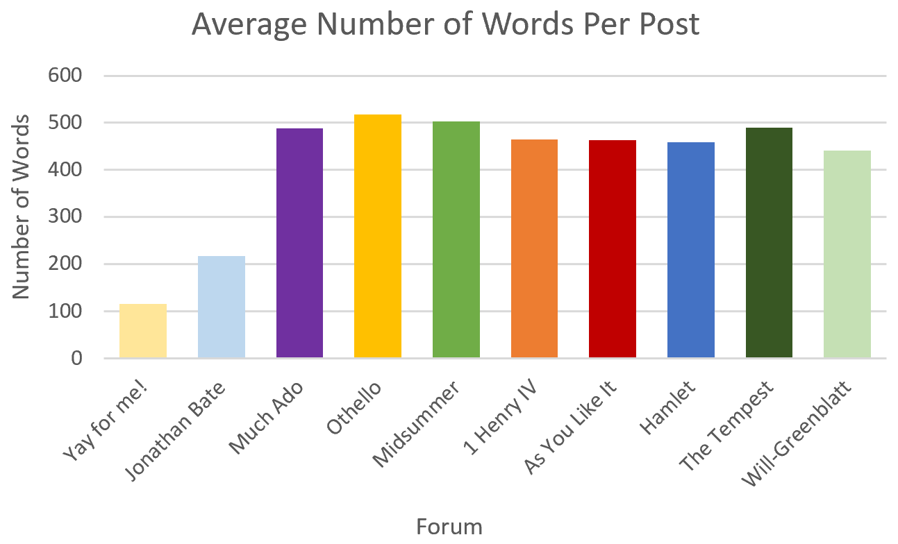
A Statistical Analysis of Discussion Forum Posts Made by Fall 2018 ENGL 338: “Shakespeare” Students
Hannah Smith
English Department
Background
The ENGL 338: “Shakespeare” course, taught by Professor Debra Rienstra, was deeply engaging and incredibly fun. Discussion and enthusiasm was fostered inside and outside of the classroom, and one result of this was active and productive online class discussion forums. Shortly after the conclusion of the course, I found myself still thinking on the various topics and conversations of the course and became curious about the posting habits on the class’ online forums, which had been so unlike my prior experiences with such things. I then decided to collect data from each forum as well as all of them collectively to see what kind of picture the data would paint.
Description
I looked at 11 elements of the course’s 10 forums and 15 elements of the forums collectively, including the number of participants per forum, the average number of words per forum post, and the average number of posts submitted before and after the deadline. Then I charted and graphed the data.
Findings
Among other things, I found that students completed significant informal writing during the semester. On average, each student wrote about 4,200 words on the forums in total—that’s the equivalent of an additional 13-page paper.
Below is a sample of some of the graphed data.
Acknowledgements
Thank you, Professor Rienstra, for your excellent teaching, passion in the discipline, genuine care for your students, and so much more. And thank you to all of my classmates in ENGL 338. It was an honor and a joy to study with you.

